Slide 1

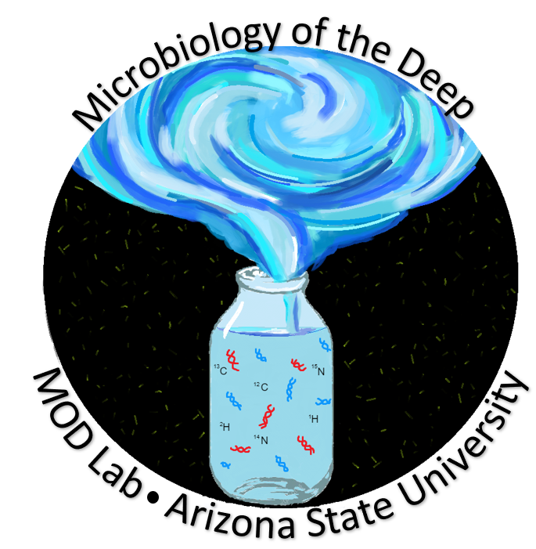


Habitability of Extremophiles
Adrianna Matthews, Jon Zaloumis, Vince Debes, Dr. Elizabeth Trembath-Reichert
Arizona State University, The School of Earth and Space Exploration
ASU / NASA Space Grant
Arizona NASA Space Grant Consortium Symposium
April 23, 2022
Notes:
Hello, my name is Adrianna Matthews. I’m studying Astrobiology and Biogeosciences at The School of Earth and Space Exploration at Arizona State University and my research is about the Habitability off Extremophiles. I’m going to start with a few quick definitions to make sure we’re all on the same page.

Slide 2
What are Extremophiles?
Organisms that live in extreme conditions, including:
  Hyperthermophiles, > 80°C
  Psychrophiles, < 20°C
  Extreme Halophiles, > 14.6% salinity
  Non Halophiles, < 1.2% salinity
  Hyperpiezophiles, > 50 MPa
  Hypopiezotolerants, < 0.1 MPa
  Hyperacidophiles, < pH 3
  Hyperalkaliphiles, > pH 11
Polyextremophiles grow in multiple extreme conditions.
Notes:
So what is an extremophile? Extremophiles are organisms that live in extreme environments. There are many classifications of extremophiles but throughout my research, I have focused on those that you see here. So, (list them all).
I also focus on polyextremophiles throughout my research, or organisms that can live in multiple extremes. For example, if you imagine a hydrothermal vent at the bottom of the ocean, the microorganisms that dwell around this area must content with high pressures, hot temperatures, and in the case of most black smoker vents, high acidity. Therefore, they are polyextremes.

Slide 3
Metabolism
Heterotrophs obtain nutrition from other organisms, using organic material.
Autotrophs obtain nutrition from inorganic molecules.
Photoautotrophs use energy from light.
Chemoautotrophs use energy from inorganic chemical reactions.
Methanogens obtain nutrients from methanogenesis, the generation of methane.
Notes:
Not only do I want to know the environment in which extremophiles and polyextremophiles can be found dwelling, but I also want to know what their metabolisms are to have a better grasp on the organisms that might be best served for analogous environments outside of Earth when searching for life. Therefore, (describe these terms) – explain chemoautolitotrophic too.
This distinction is important because when we’re looking for signs of life elsewhere, we are more keen to look for autotrophic life. So knowing the metabolism is important.

Slide 4
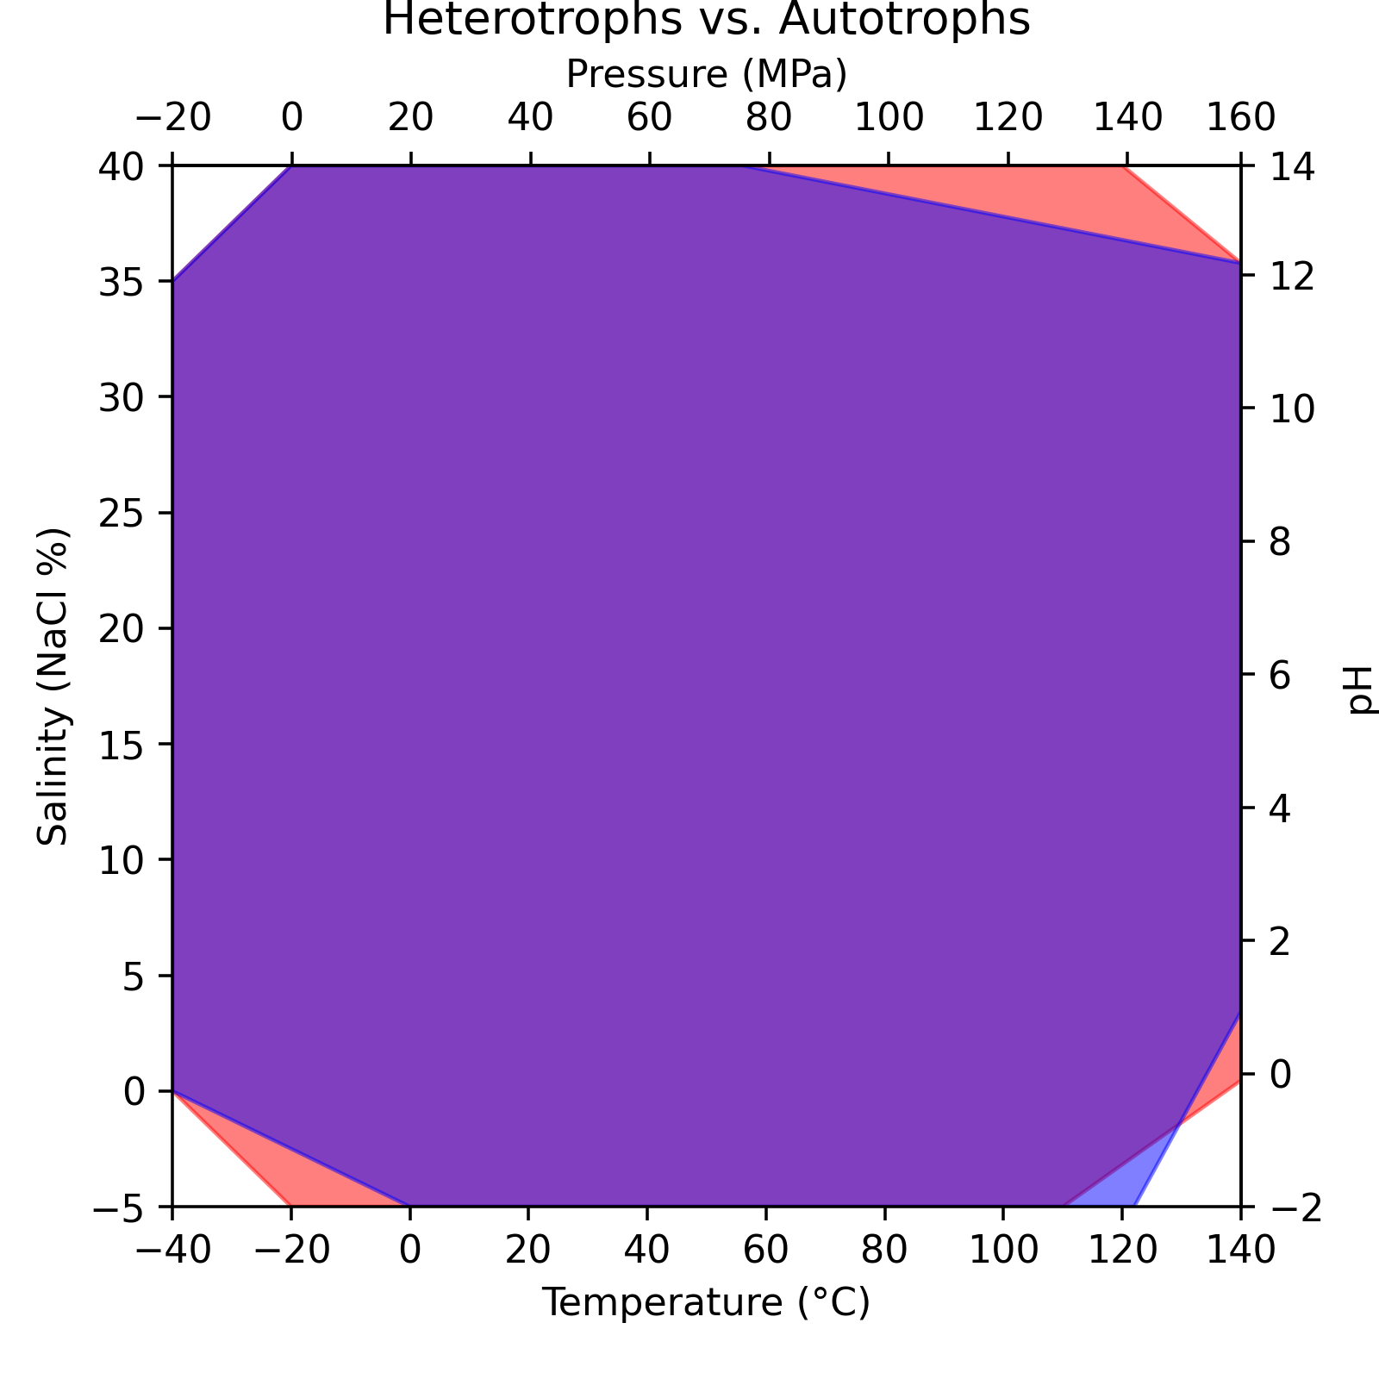
96 extremophiles, all groups included.
Known limits of growth:
  Temperature: -20 – 122 °C
  Salinity: 0 – 35% NaCl
  Pressure: 0.0007 – 140 MPa
  pH: -0.06 – 12.5 pH
69 Heterotrophs
42 Autotrophs/Methanogens
Notes:
After conducting a literature review of 96 extremophiles, I have determined the current known limits of life and their correlating organisms. Those limits of life are set to (explain). Now when looking at these plots I’m sure it’s tempting to go to a spot in the middle and ask “What grows at this temperature, salinity, pressure, and pH?” But the way to read these plots is not by looking in the middle, but instead by looking at the outside boundaries of the plot itself. What I’ve done is plot the maximum and minimum growth along each boundary. Looking at temperature for instance, I’m not saying that all 96 organisms were capable of growing at this large range. Instead, I’m saying that at least one organism was able to grow at -22 C and another was able to grow at 122 C
This plot is further representing heterotrophic and autotrophic growth, which I have color coded here for you. So heterotrophic growth is shown in red while autotrophic growth is shown in blue and the overlap is the ability to grow either way. If we take a look at the salinity boundary, hyperhalophiles and nonhalophiles are show in the literature to not have much of a distinction for their growth. This is the same with the pH boundaries, other than the most extreme acidophiles. For pressure, we see that at a pressure of 80 MPa, heterotrophic takes over, according to the literature, and the most extremely growing psychrophiles are also heterotrophic. Where we finally see a difference is in this very niche group of hyperthermophiles ranging from about 110 C to 122 C where autotrophic growth is primary. This is an important distinction as when searching for signs of life on another planet we want to focus our efforts on autotrophs.

Slide 5
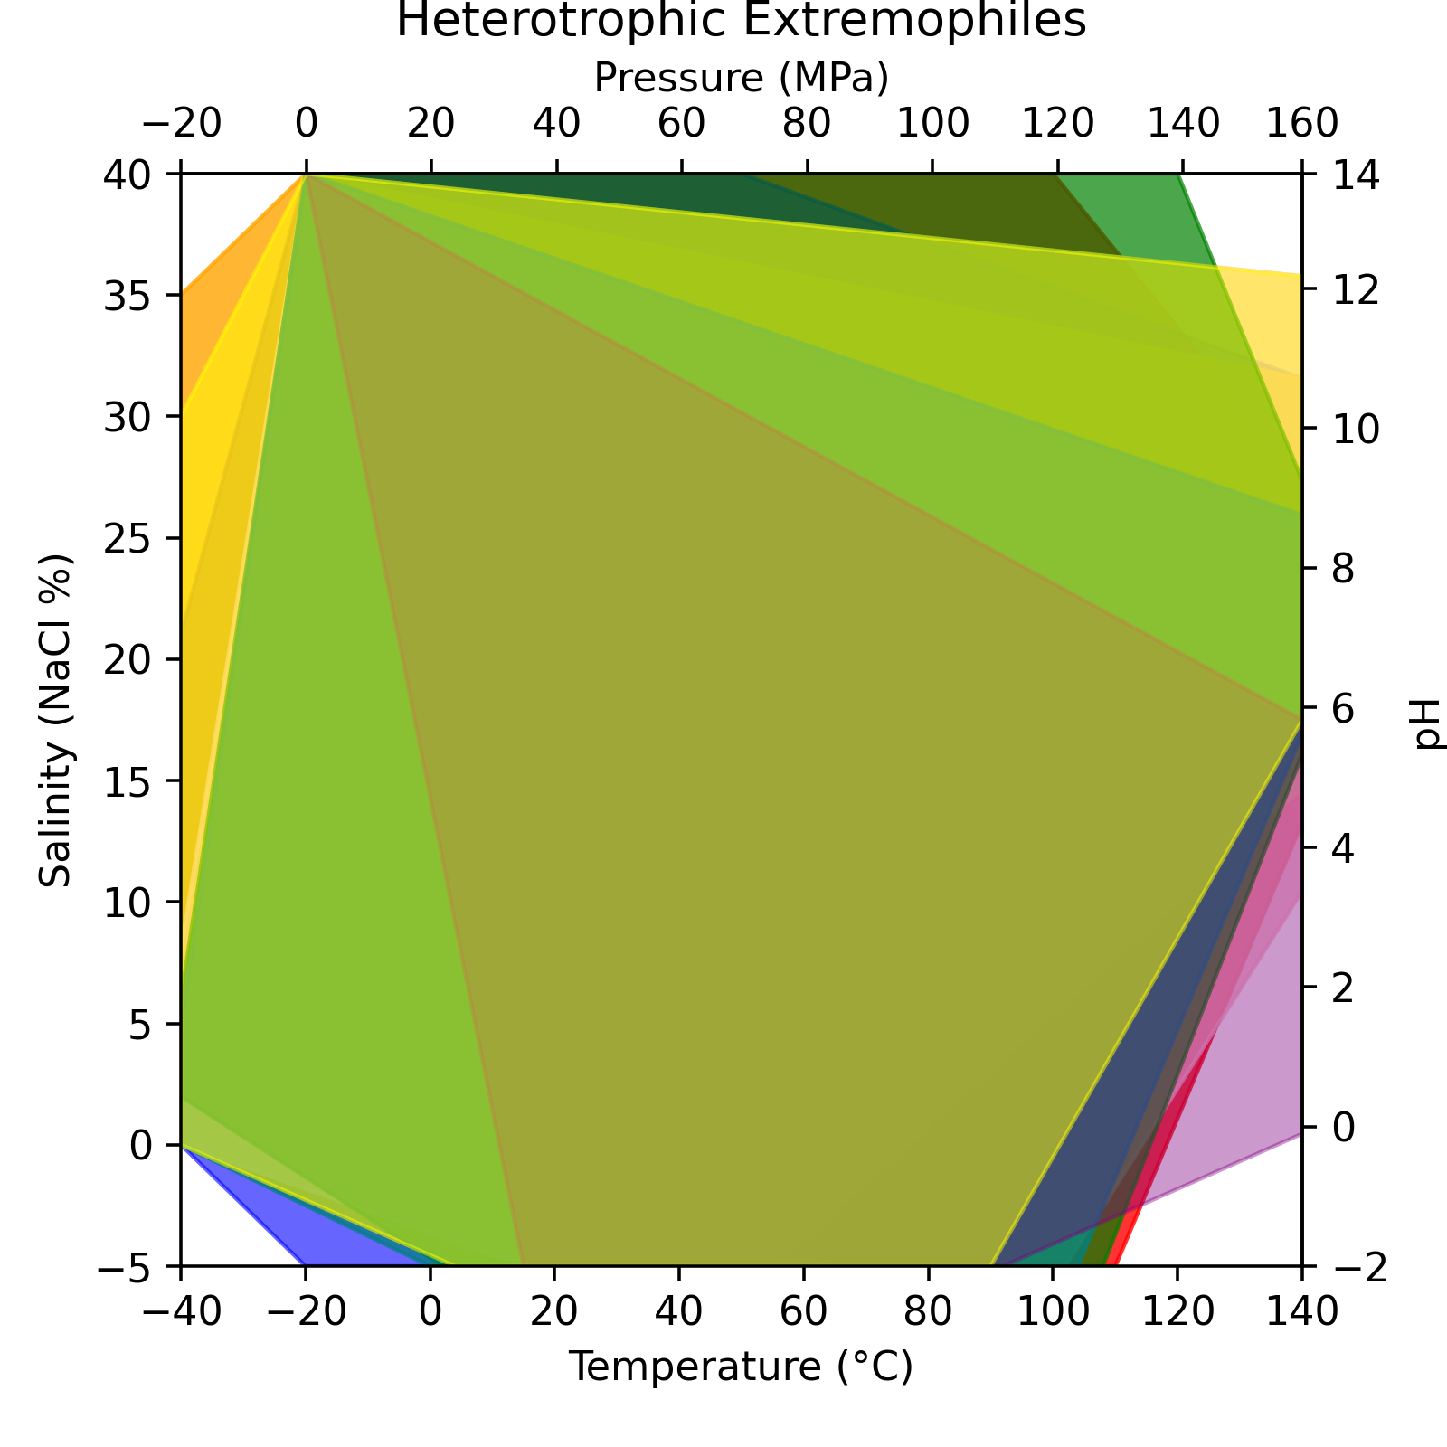
8 Hyperthermophiles
10 Psychrophiles
10 Extreme Halophiles
10 Non-Halophiles
9 Hyperpiezophiles
6 Hypopiezotolerants
7 Hyperacidophiles
9 Hyperalkaliphiles
Notes:
Now I’m going to show you all my rainbow plots. So again, I know it’s tempting to look in the middle, especially with the colors here, but try to focus on the boundaries of the plots. Here, I’m looking at the extremophilic groups grown heterotrophically, and these groups are color coded to the right. One distinction I will quickly point out is that when I say green for hyperpiexophiles, I mean the green from the range 120 t o140 MPa and when I show teal for hypopiezotolerant organisms, I mean the color between about 90 to 105 C.
When you look along the edges of this plot, you’ll notice that some colors are overlapping while others aren’t. The overlap of colors here represents polyextremophilic growth while stand along colors such as the orange on the salinity side of the plot between 30 and 35% NaCl is representative of halophilic growth and that is it, not other kind of extremophilic group is represented here. If we move away from salinity and to the pressure side, we can see that between 120 and 140 MPa, only hyperpiezophiles are represented here. If we go down to the bottom looking at temperature, we see that between 0 and -20 C we only see psychrophilic growth, whereas there is primarily polyextreme growth everywhere else along this boundary, until we get to a very niche group of hyperthermophiles that only grow thermophilically around 110 C. If you take a look at the pH side, you might want to say that there is a mixture of polyextremophile and extremophile growth, but what you can’t see is the overlap of the non halophile pink color along the pH boundary. Therefore, polyextremes represent the entire pH boundary.

Slide 6
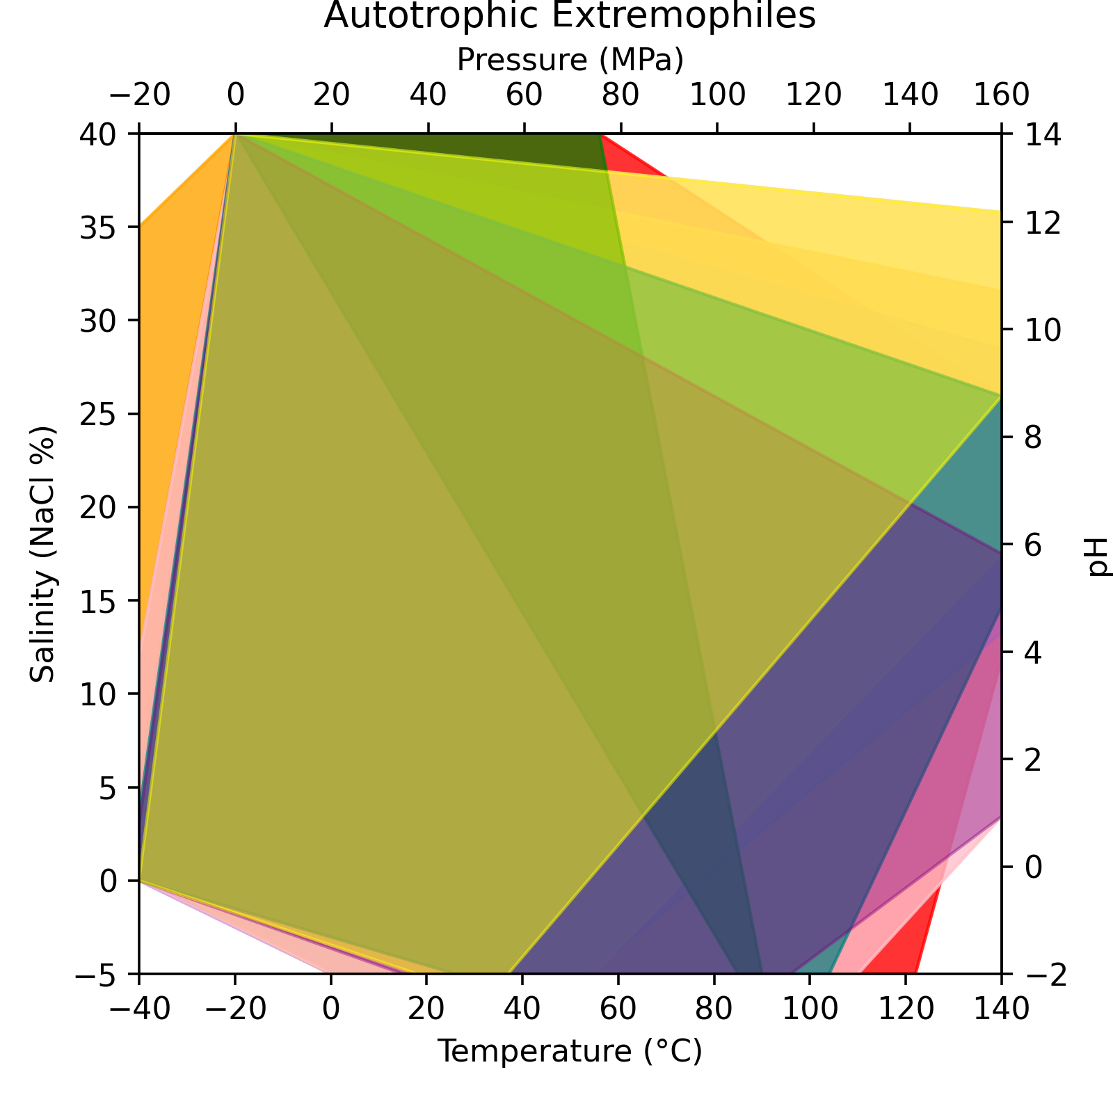
9 Hyperthermophiles
6 Psychrophiles
3 Extreme Halophiles
10 Non-Halophiles
1 Hyperpiezophiles
5 Hypopiezotolerants
6 Hyperacidophiles
2 Hyperalkaliphiles
Notes:
Now, when we look at the autotrophically growing organisms, we can see a difference. Starting at the salinity side again, we see that the range of polyextreme growth has declined, with strict hyperhalophilic growth from 13 to 35% NaCl. When looking at pressure, we see that these organisms are all polyextremiophilic, and when going over to the pH side the exact same thing is occurring, all polyextremophilic growth. When we then go to the temperature side, we can see that there is no longer psychrophilic growth on its own, but rather much more polyextremophilic gowth, unable to reach -20 C in this case. However, I said before, most of the hyperthermophiles were able to grow autotrophically and we can see that here, with a wider range from about 110 to 120 C representing strictly thermophilic growth.
Now remember to keep in mind that there are certain organisms whose other extremes were not tested for. For instance, a thermophile called geogemma barrossi strain 121 grows at 121 C and the paper I found claimed it to grow at high pressures, but the number for this growth was not provided. Therefore, it is possible that some of these hyperthermophiles might grow as polyextremes, but we won’t know until we conduct more experiments, especially pressure experiments. I will also say that every single halophile I looked at had no information for pressure at all, another area where we could improve.

Slide 7
Acknowledgements
I would like to thank the following people for their support and help throughout my time as an ASU / NASA Space Grant Intern:
Dr. Elizabeth Trembath-Reichert (mentor)
Dr. Everett Shock (mentor)
Jon Zaloumis
Vince Debes
Grayson Boyer
MOD Lab colleagues
GEOPIG Lab colleagues
ASU / NASA Space Grant

Slide 8
Thank you!

